Slide 1


Understanding Twitter Sentiment on Apple and Google Products.
Exploring user sentiment towards tech giants' products through social media analysis.

Slide 2

Content
Introduction
Business Overview
Business Problem
Objectives
Data Understanding
Methods
Visualizations
Modelling
Results
Deployment
Conclusion

Slide 3
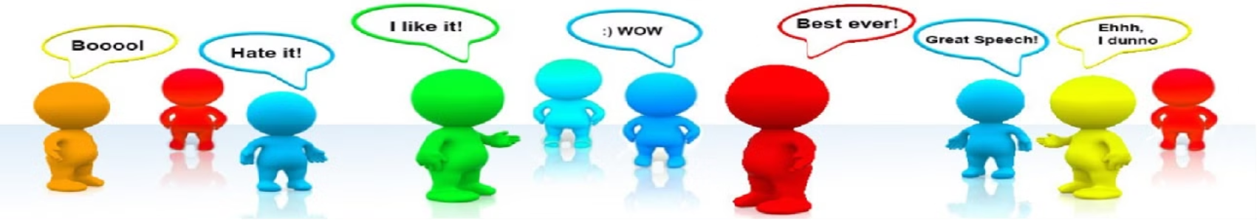
Introduction
Public opinion shapes business strategies in today's interconnected world, where social media influences daily decisions. Consumers constantly share opinions about the products they use, creating a rich pool of data.
For companies like Google and Apple, analyzing this sentiment is crucial to understanding customer perceptions, staying relevant, and adapting to trends. By leveraging sentiment analysis, businesses can align their strategies with public opinion, enhancing their competitiveness and ensuring long-term success.

Slide 4
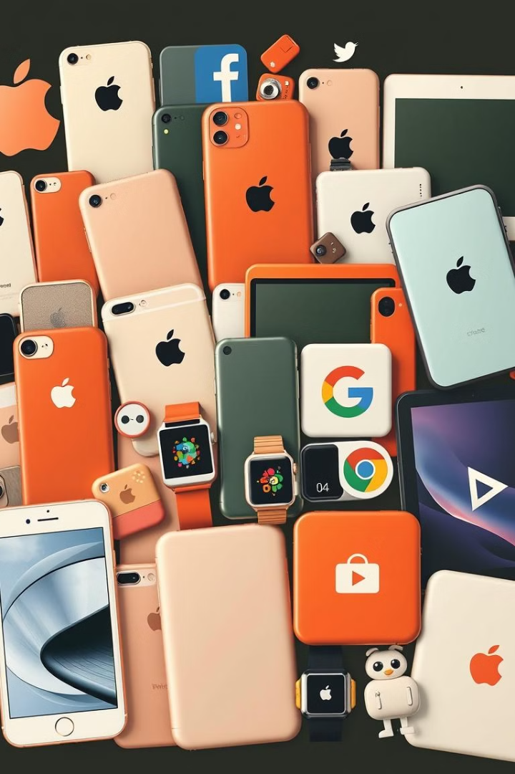
Business Overview
Sentiment Flow Analysis
Aims to tackle the real world problem related to understanding public sentiment towards Apple and Google products on Twitter .
Key Stakeholders
Apple, Google, and their dedicated teams (marketing& Customer support).

Slide 5

Business Problem
This project analyzes Twitter sentiments to understand customer satisfaction with Apple and Google products. We classify tweets as positive, negative, or neutral, providing insights into customer feedback. This data can help identify emerging issues, guide product improvements, and inform marketing and customer support strategies.understand customer satisfaction, identify potential issues and tailor their responses accordingly.

Slide 6


Objectives
Key Objective
Develop an NLP multiclass classification model for sentiment analysis to categorize sentiments as Positive, Negative, or Neutral, with a target accuracy and recall above 80%.
Specific Objectives
To Identify the most common words used in the dataset using Word Cloud .
To confirm the most common words that are positively and negatively tagged
To recognize the most opined products by users
To spot the distribution of sentiments

Slide 7

Data Understanding
1
Source of Data: The dataset originates from CrowdFlower via data.worldInitial Dataset
2
Products being focused on: Apple & Google Products
3
The data : Twitter sentiments
Data Description: Over 9000 rows and 3 columns
4
The sentiments : Positive, Negative & Neutral.
5
The columns :
Tweet text (Tweet)
Emotion in tweet is directed at (Product)
Is there an emotion directed at a brand (Emotion)

Slide 8
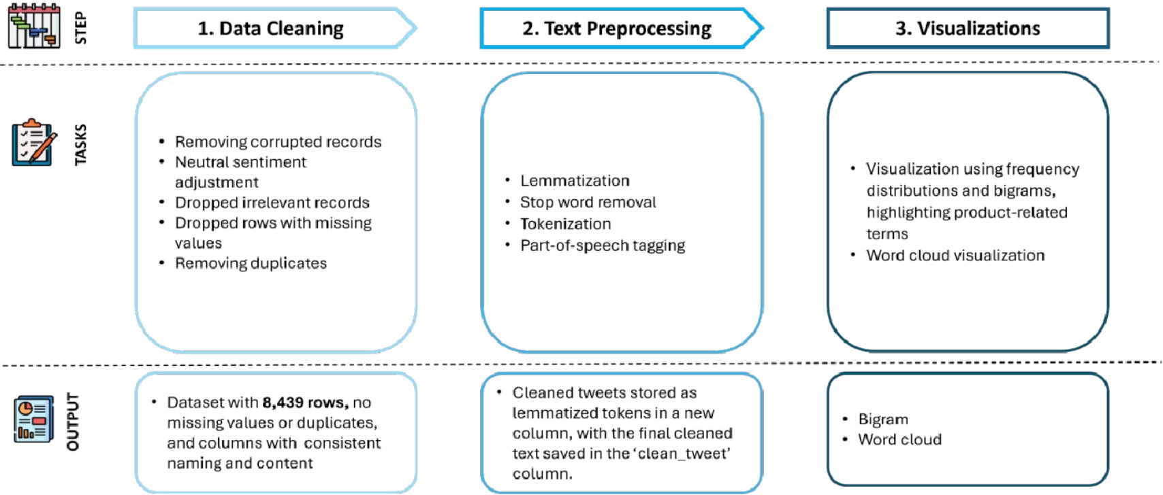
Data Preparation

Slide 9


Data Visualization .

Slide 10
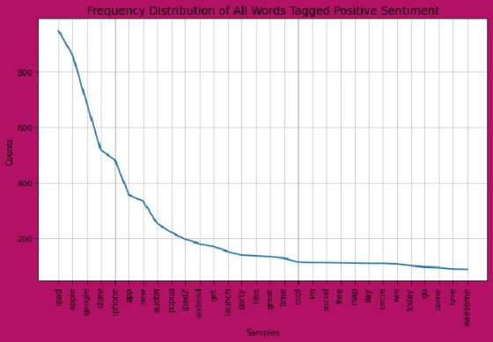
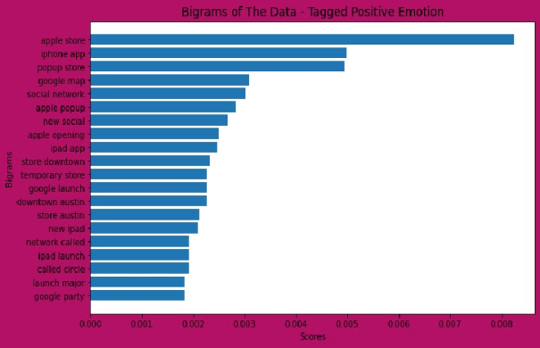
Positive Emotion Visualization
The most frequent words used were ‘ipad’, ‘apple’, ‘google’. The count is between 600-870
‘Apple store’, ‘iphone app’ and ‘popup store’ were the most frequent word combinations used.

Slide 11
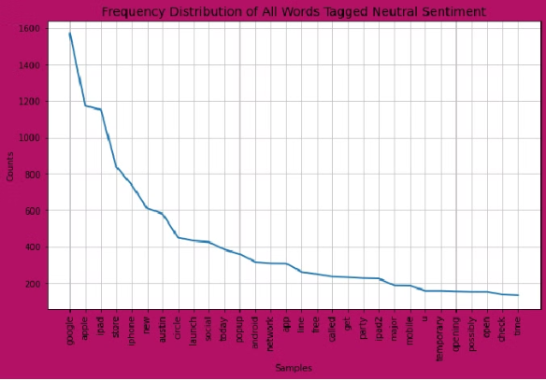
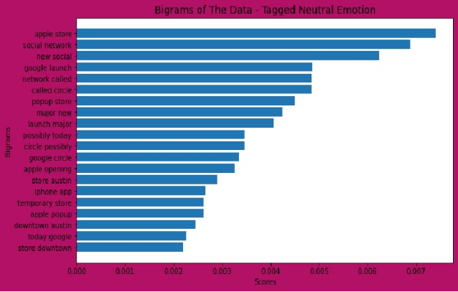
Neutral Emotion Visualization
The words 'google', 'apple‘ and 'ipad' appeared more frequently than all other words. The count being over 1000 thus proving class imbalance
‘Apple store’, ‘social network’ and new social’ had the highest scores. Note the scores are slightly lower than Positive Emotion.

Slide 12

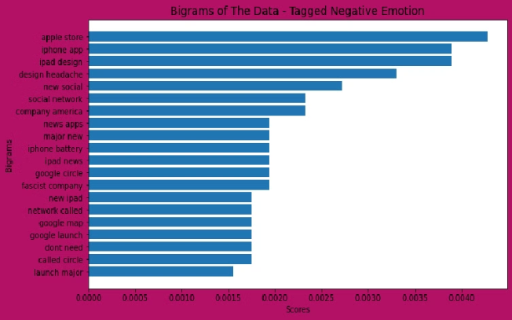
Negative Emotion Visualization
The words 'ipad', 'iphone', 'google' and 'apple' appeared more frequently than all other words. however the count is less than neutral and positive sentiments
“Apple store’, ‘iphone app’,
‘ipad design’
had the highest scores.

Slide 13
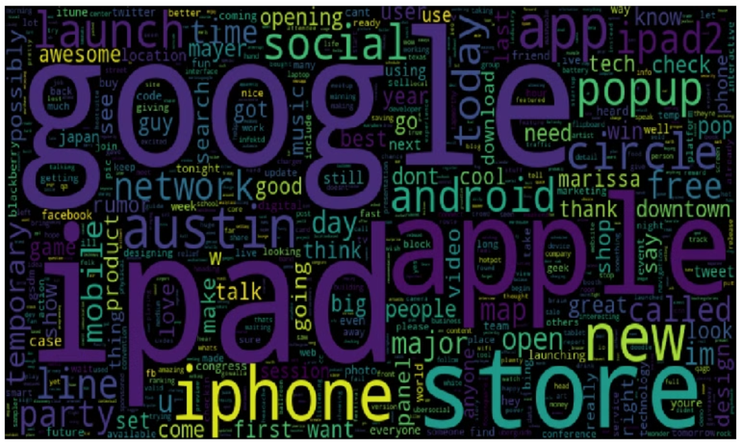
Word Cloud
The words google, ipad, apple, store and iphone are the most visible words used in the dataset

Slide 14

Modelling

Slide 15
Text Preparation for Modeling
Label Encoding:
1
Converting emotion labels into numerical values.
2
Vectorization:
Using TF-IDF and Count Vectorizer to transform text data into numerical vectors.
SMOTE:
3
Applying SMOTE (Synthetic Minority Over-sampling Technique) to handle class imbalance.
4
Train-Test Split:
Split the dataset into training and testing sets for model evaluation.

Slide 16
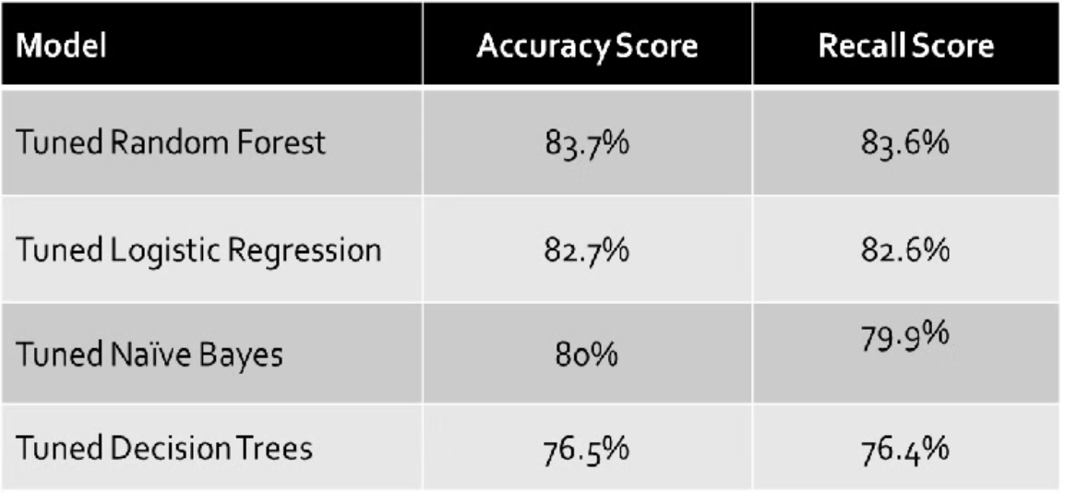
Model Performance
The Best Model was the Random Forest Model.
Logistic regression was quite close but due to this project being about solving a classification problem, Random Forest classifier was the best option for deployment.
Models were produced after hyper parameter tuning and TF-IDF Vectorization .

Slide 17
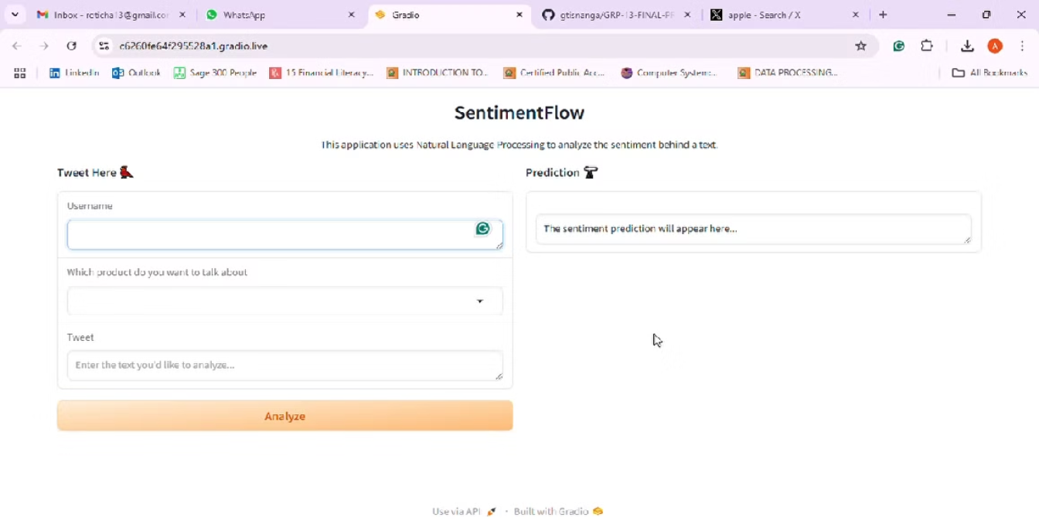
Deployment

Slide 18



Conclusion
Project Summary
We successfully employed machine learning model to classifying tweets into emotion categories for Apple and Google Products.
Project Impact
The project’s results offer valuable insights into effective sentiment analysis for social media data. The models developed provide robust tools for classifying tweets and understanding public sentiment, contributing to advancements in sentiment analysis and machine learning applications.
Room for Improvement
The project highlights the importance of effective data preprocessing, model evaluation, and hyper parameter tuning in achieving high-performance sentiment analysis. The findings emphasize the potential of machine learning models in practical applications and pave the way for future research and enhancements in the field.

Slide 19
Recommendations
Real-Time Monitoring
Scalability:
Real-Time Processing:
Continuous Monitoring:
Optimize models to handle large-scale data efficiently for high-volume tweet processing.
Implement alert systems to flag negative sentiments for prompt customer issue resolution.
Enable real-time sentiment analysis to support timely decision-making and trend response.
Regularly track model performance, retraining with new data to ensure accuracy and relevance.
Platform Integration:
Connect models to social media APIs for seamless data collection and continuous insights.

Slide 20

Team
Amos Kipng'etich
Alex Miningwa
Angela Maina
Charles Ndegwa
Gloria Tisnanga
Sandra Koech
Sylvia Manono

Slide 21

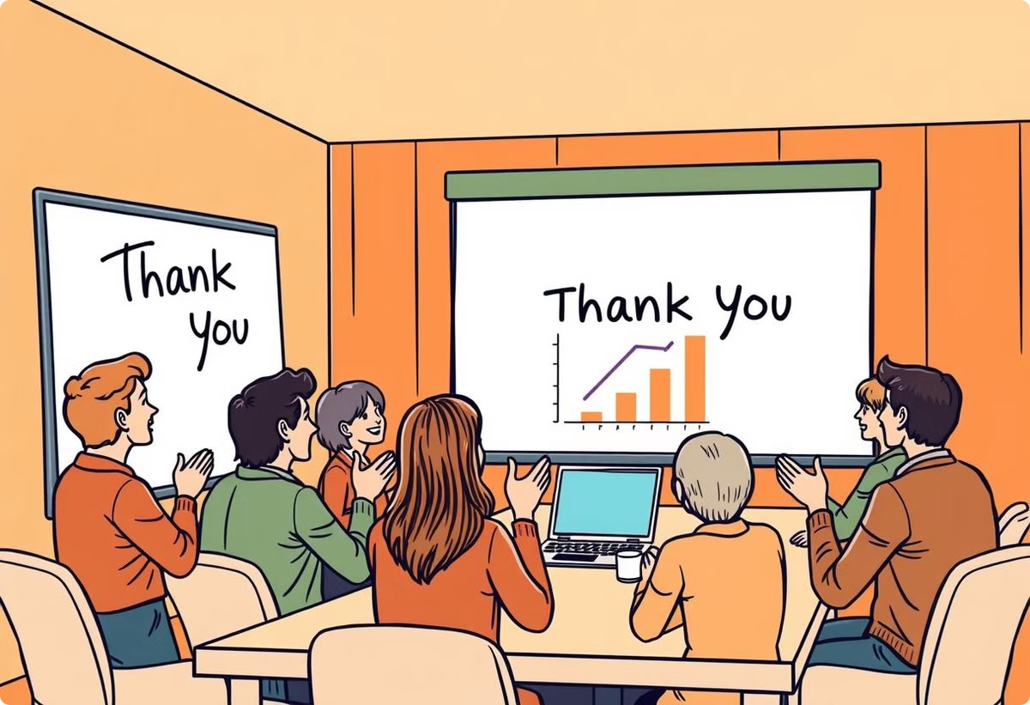
THANKYOU
Questions
& Clarification.

